Slide 1
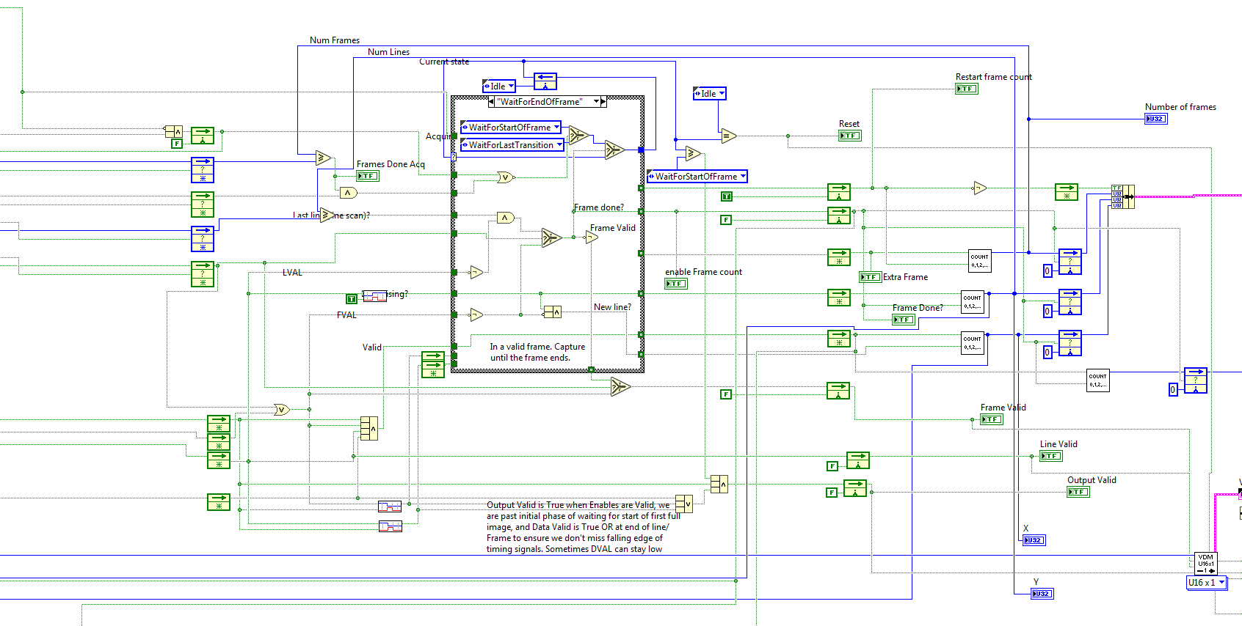
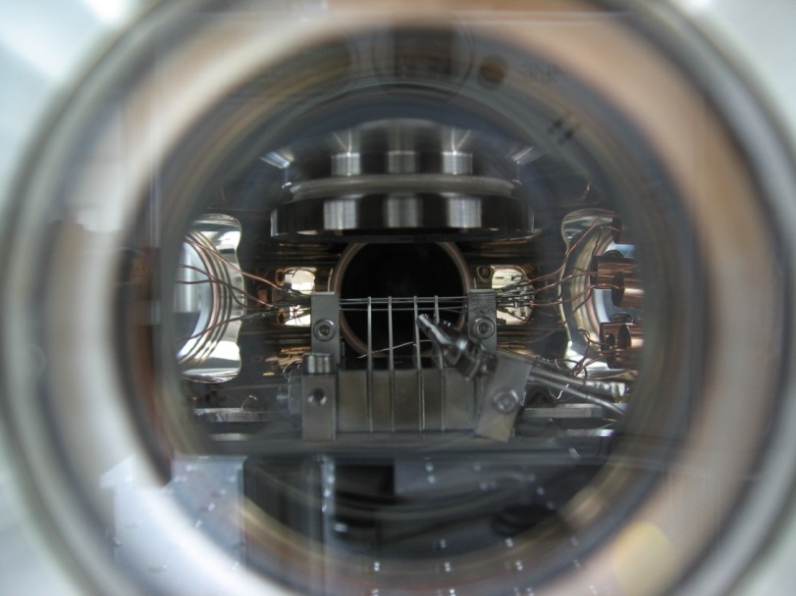

Real-time Detection & Coherent Feedback in Trapped ions
MICE 2019
Lior Gazit, Tom Manovitz

Slide 2
Thank You Ion trappers
Roee, Nitzan, Ravid, Ruti, Tom, Yotam, Meirav, Lee, Jonathan, David, Haim, Sapir

Slide 3

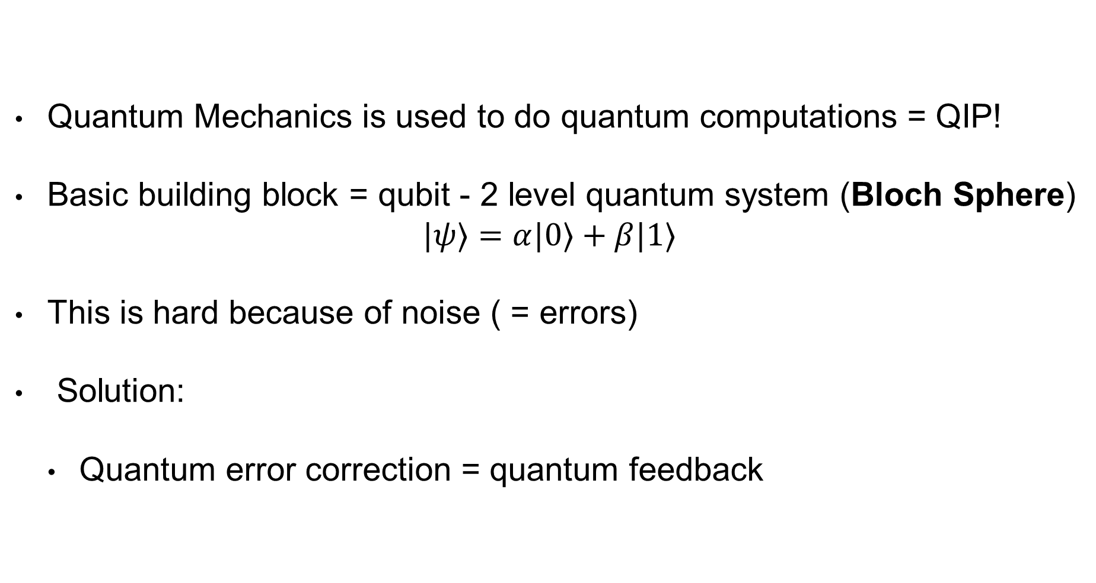
Motivation
Quantum Mechanics is used to do quantum computations = QIP!
Basic building block = qubit - 2 level quantum system (Bloch Sphere)
$$|ψ⟩=α|0⟩+β|1⟩$$
This is hard because of noise ( = errors)
Solution:
Quantum error correction = quantum feedback
Notes:
QIP is a field which deals with controlling quantum carriers of information to perform computational tasks.
QIP is great – why? The Hilbert space of quantum theory –namely Superposition and entanglement introduce verity of computational tools that in some manner can be more sufficient and some time not allowed in classical computation.
The basic building block of QIP is the Qubit. Quantum analog to classical bit. It’s a 2 level quantum system that any QIP involves controlling manipulating and measuring a qubit(s).
But this processes are noisy - gate are not prefects, the environment is hostile and to over come noise and to get fault tolerant computations we have QEC.

Slide 4
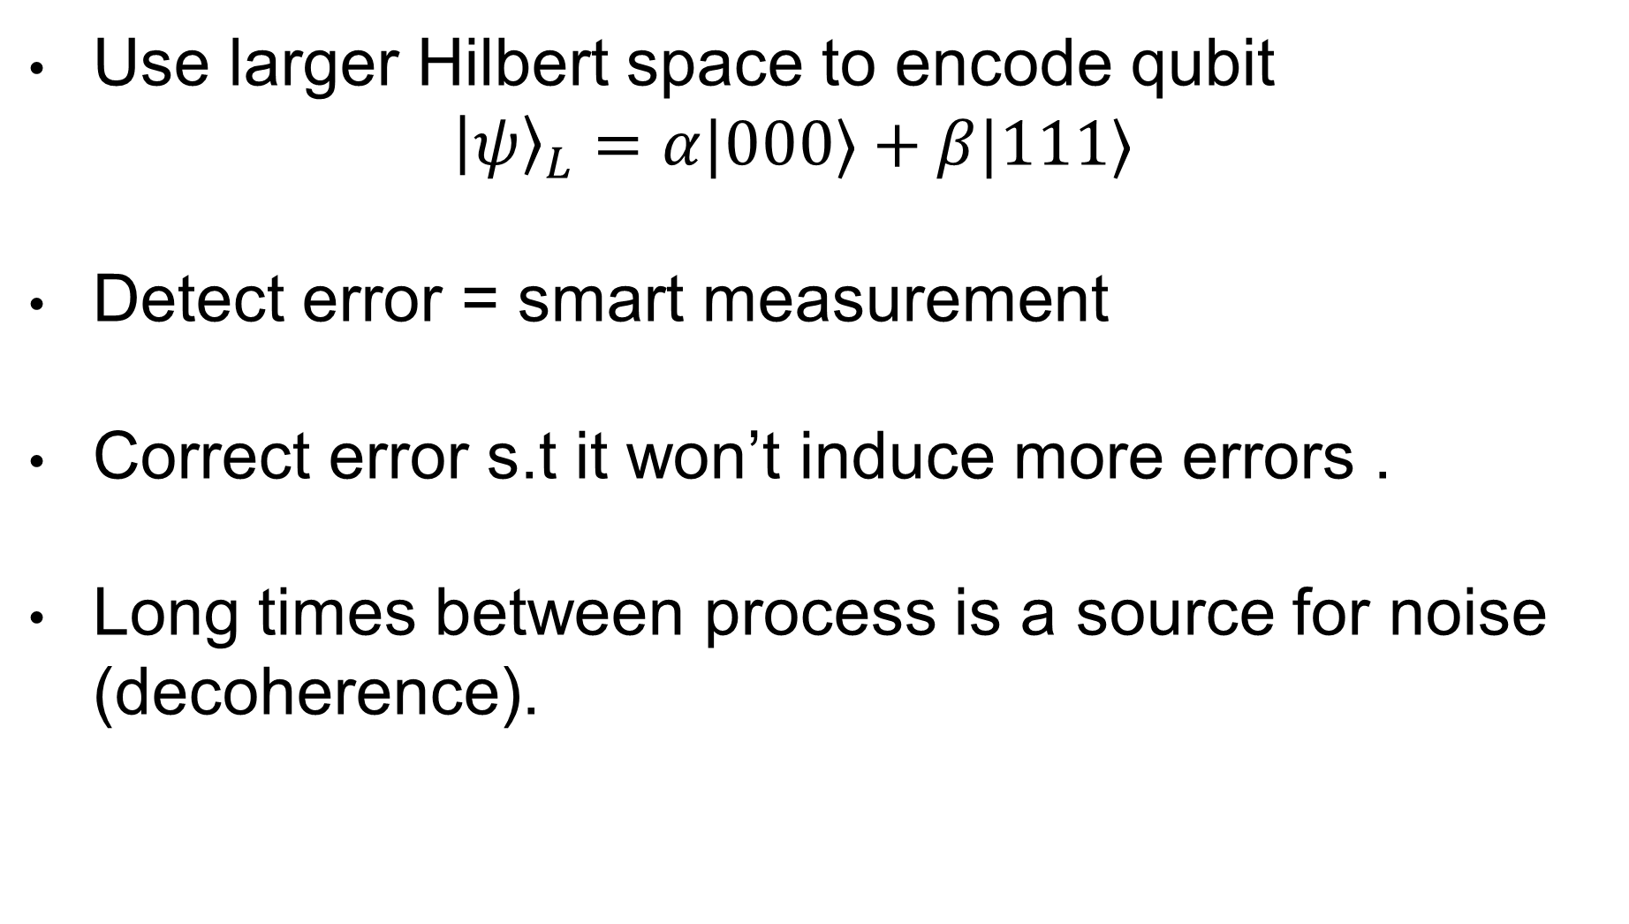
Quantum error correction
Use larger Hilbert space to encode qubit
$${\left|ψ\right\rangle }_{L}=α|000⟩+β|111⟩$$
Detect error = smart measurement
Correct error s.t it won’t induce more errors .
Long times between process is a source for noise (decoherence).
Notes:
QEC is the way QIP deals with noise – This is a set of algorithms that uses the fact that we can encode the qubit information to a larger Hilbert space and by that enables us to first – detect the error – by using a smart measurement that collapse our wave function to either a subspace where the error is corrected or a subspace where the error is detected and can be corrected using feedback or other tools.
The correction of the error as long as the rest of the steps needs to be s.t. it will not induce more errors than the error rate itself.
One of the noise sources is time itself that can cause dephasing and de-coherence. (more prone to magnetic noise etc..)

Slide 5
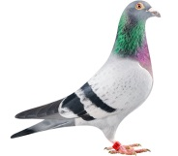

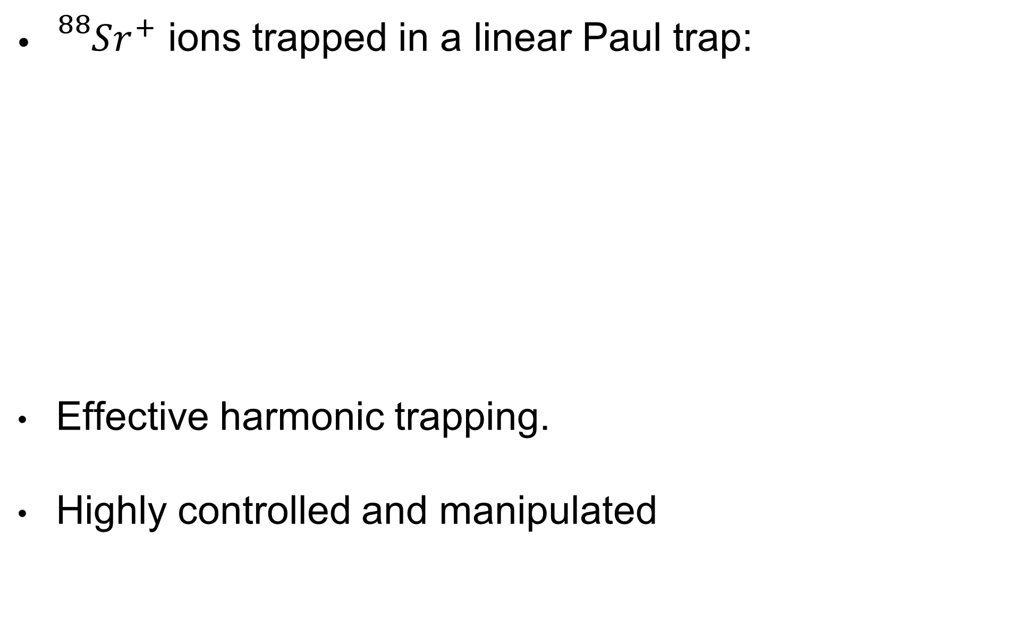



Our system: Trapped ions
X
${}_{}^{88}{Sr^{+}}$ ions trapped in a linear Paul trap:
Effective harmonic trapping.
Highly controlled and manipulated
$$\sim$$
$$V_{EC}$$
$$V_{DC}$$
$$V_{RF},Ω_{RF}$$
Notes:
Trapped ions are systems where ions are electrically trapped in (usually) linear chains. These systems are well understood and highly controllable and are thus considered a leading platform for QIP experiments. The ions have typically long life times in the trap and may be cooled, initialized, controlled and measured by applying microwave transitions. Typically a short lived fluorescent internal transition is used to Doppler cool and measure the ion state, and two internal long lived levels are used to encode the logical state |0⟩ and |1⟩. The normal modes of ions in the crystal can be treated as uncoupled harmonic oscillators, which can selectively couple between different ions.

Slide 6
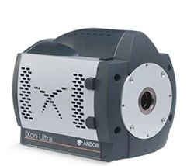
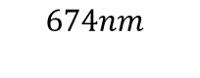
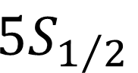
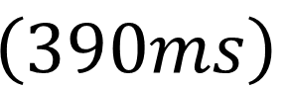
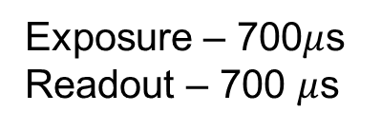
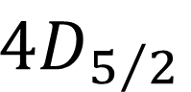
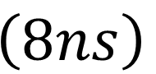

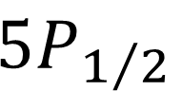
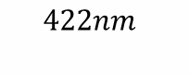
$Sr^{+}$ as Qubit
Hilbert space structure:
$5P_{1/2}$
$4D_{5/2}$
$$\left(8ns\right)$$
$$\left(390ms\right)$$
$$422nm$$
Exposure – 700$μ$s
Readout – 700 $μ$s
$$674nm$$
$5S_{1/2}$
Notes:
This is the energy level scheme of the Sr atom after ionized. We are intrestead on 3 levels – S,D which are long lived levels and the P which is short lived
This is why we are encodeing our qubit on S and D to allow state selective florescence detection scheme.

Slide 7

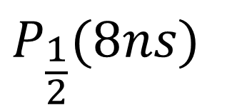


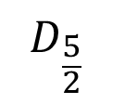
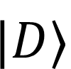
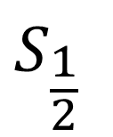

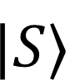
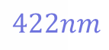
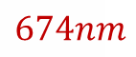

Detection
state-selective fluorescence
$$P_{\frac{1}{2}}(8ns)$$
$$D_{\frac{5}{2}}$$
$$|D⟩$$
$$422nm$$
$$674nm$$
$$S_{\frac{1}{2}}$$
$$Sr^{+}$$
$$|S⟩$$
Exposure – 700us
Readout – 700us
Objective
Trap
$$\sim$$
$$V_{EC}$$
$$V_{DC}$$
$$V_{RF},Ω_{RF}$$
Notes:
We are using a detection scheme that is state selective flourecence.
This is done by manipulating the electron to different electronic levels here in one of them the electron will decay back and will emit a photon ( This will be bright stste)
And the 2nd level will be a long lived level that the electron does not decay from ( during the exposure time) and thus will not scatter photons.

Slide 8
Experiment
For N=1:Exp. repetition
Cooling
Exp. Sequence ( Gates, Qubit rotations, etc.)
measurement
Problem
Data access only at the end of experiment (after the N repetitions)
Cannot perform real time operations
END
Image Processing
N
Takes ~seconds
Notes:
So when are we using this detection scheme? We need to understand how experiment works before – we are starting and experiment with some sequence., it contains cooling, some gates or other manipulations on the qubit and then we measure. And we repeat this process many times to collect statistics on the states and than analyze our experiment. The data is being collected after each repetition but is being processed on the PC only at the end of each experiment.
This is a problem if we want to preform tasks like QEC- we don’t have access to the image data – meaning the ion state between exposures. And we cannot perform coherent operations that are conditioned on the result.

Slide 9
Solution
Readout system that is connected to the camera via Camera Link communication Protocol
Allows access to live raw image data (between exposures)
Followed by a controlled feedback on the ions (according to results)
FPGA
Frame
grabber
CL
Experiment

Slide 10
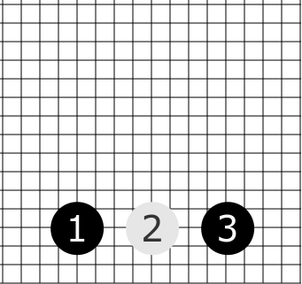
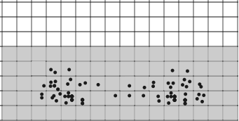


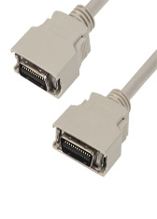

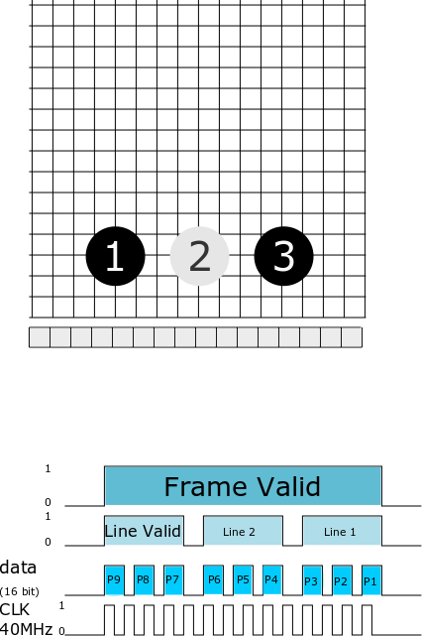
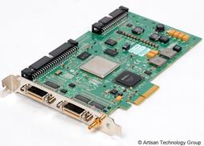

How?
20
5
Exposure – 700$μ$s
Register
Gain, Output
Frame grabber
N
Notes:
The frame grabber was specially made for this propose – to so fast image processing and it has a camera link input

Slide 11
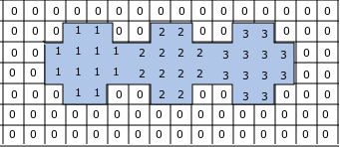
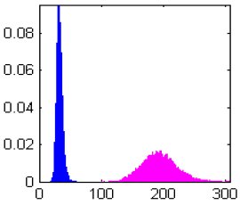
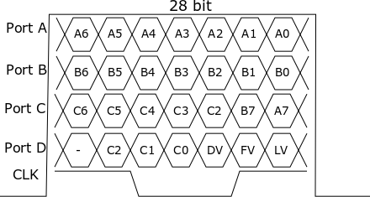
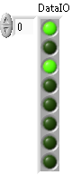
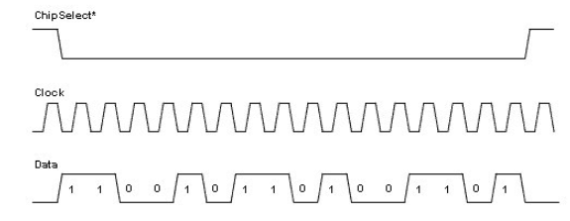

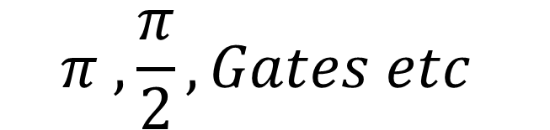
Pixel map
Known location (X,Y)
threshold
>
<
Experiment FPGA
$$π ,\frac{π}{2},Gates etc$$
Processing time ~100$μ$s
Notes:
This means that now our experiment have 2 measuremnts- one to check the state and to act apon and the 2nd meauremnt is to get our result.

Slide 12

So far…
Real time image read out and analysis
Introduced coherent feedback
Processing time “cost” ~1-5% of decoherence time (2-15ms)

Slide 13
Live Readout
Camera Link protocol
5 sync channels , 2 data Channels (ADD FIGURES)
Streams data at 40 MHz
Frame Grabber:
Image analysis - Threshold
Result - Binary array that contains the ions state (1-Bright)
Total Readout time ~100us

Slide 14
Feedback
The array is sent to the Exp. FPGA using SPI,
Operate gates operations according to results.

Slide 15
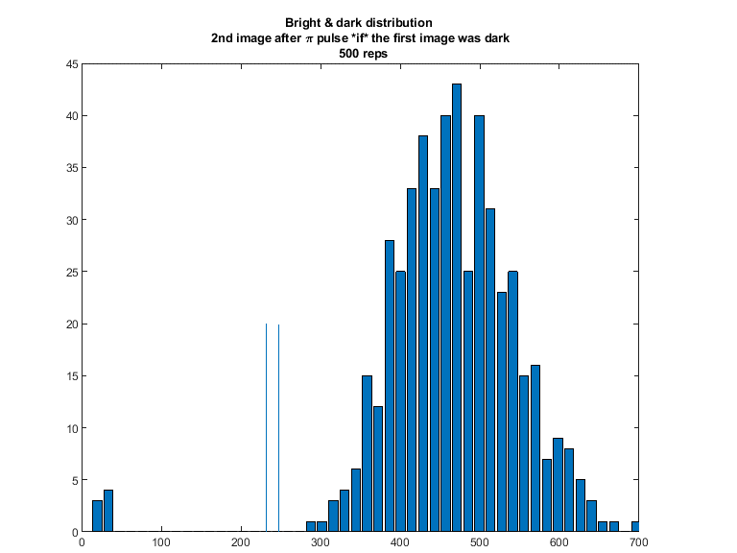
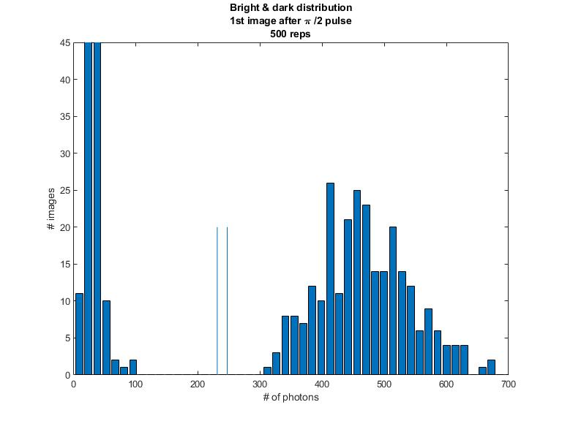
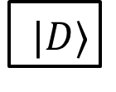
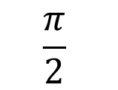
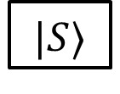
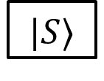
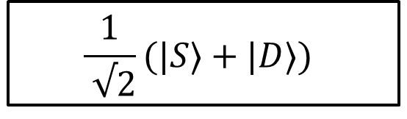
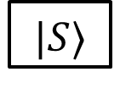
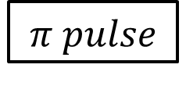
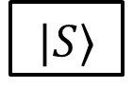

Results
1 Ion
$$|S⟩$$
$$\frac{π}{2}$$
# of images
$$\frac{1}{ √2}(|S⟩+|D⟩)$$
measure
$$|S⟩$$
$|D⟩$
Feed-back
$$Do$$
$$nothing$$
$$π pulse$$
measure
$$|S⟩$$
$$|S⟩$$
Fluorescence count

Slide 16
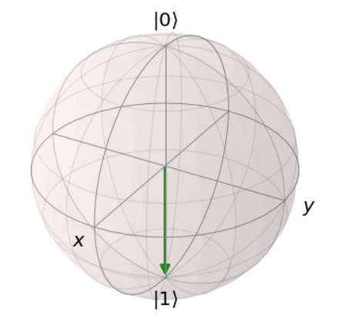
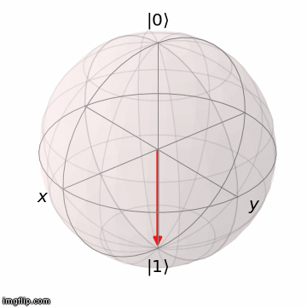
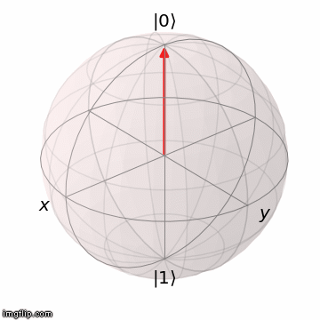
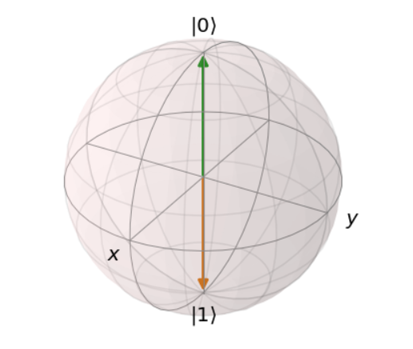
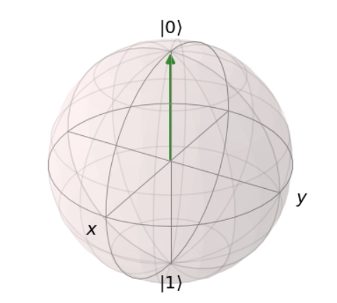
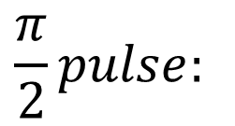
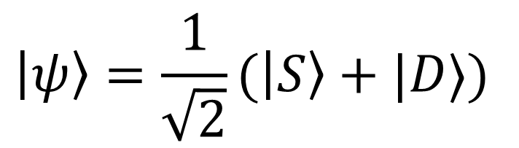
Preliminary Results
1 Ion
$$\frac{π}{2}pulse:$$
2nd part– after feedback:
If Dark - flip
$$\left|ψ\right\rangle =\frac{1}{\sqrt{2}}(\left|S\right\rangle +|D⟩)$$
# of images
Fluorescence count

Slide 17









Results
2 Ions
$$|SS⟩$$
$$\frac{π}{2}$$
$$\frac{1}{ \sqrt{2}}(|SS⟩+\left|SD\right\rangle +|DS⟩+|DD⟩)$$
Hide 2nd ion
Measure 1st ion
$$\left|S\right\rangle ⊗(\left|S\right\rangle +|D⟩)$$
$$\left|D\right\rangle ⊗(\left|S\right\rangle +|D⟩)$$
Feed-back
$$\frac{π}{2} pulse$$
$$phase φ$$
$$\frac{π}{2} pulse$$
$$phase φ+π$$
Population in S
measure
Phase

Slide 18








Preliminary Results
2 Ions
$5P_{1/2}$
$4D_{5/2}$
$$\left(390ms\right)$$
Coherent feedback experiment sequence
1st part:
$\frac{π}{2} on both ions$, Hide the 2nd , Measure: $\frac{1}{\sqrt{2}}\left((\left|0\right\rangle + | 1\right\rangle )⊗|0⟩)$
$$422nm$$
$$674nm$$
$5S_{1/2}$
SS DS SD DD

Slide 19








$5P_{1/2}$
$4D_{5/2}$
$$\left(390ms\right)$$
Part II
Unhide
conditioned $\frac{π}{2}+φ (or\frac{ π}{2}+(φ+90)$) on 2nd ion, measure (200 Reps*10exp)
$$422nm$$
$$674nm$$
$5S_{1/2}$
Population in S
Phase
Fidelity ~ 83%
Notes:
Here we can see 2 things – first that we can give feedback to selected ions – and 2nd that the feedback is still fast enough that we don’t loose coherence and we can scan the population of the super position.
Ramsey experiment – or the ramsey fringe tells us what is the phase difference between our superposition state (that is evolving at the rate of the detuning) to the state of the ion

Slide 20

1st part
SS
DS
SD
DD
Population in S
SS DS SD DD
Phase

Slide 21




Preliminary Results
2 Ions + Entangling gate
Experiment sequence:
MS gate, Hadamard on 1st ion (change to X basis) , Hide the 2nd , Measure.
Unhide, $π\backslash 2+φ or π/2$ according to result, measure (200 Reps*10exp)
Why?
Fidelity issues:
- MS ~ 90%
- Hiding + detection ~ 80%
Dephasing issues
Population
Phase
Notes:
This is not even close to good result.. But we can see here something that is really cool – This is Quantum mechanics –
We create an entangled pair, measure just one of them a different basis such that the second one collapses to a superposition and still remain coherent .
This is a cool application of the feedback system – why? – We are using entanglement to collapse the 2nd ion to a super position. And of we didtnt had the feedback system we would get 50-50 result. But we can determine the phase that we are giving to the superposition that is coherent to the results and to get a fringe and see the “superposition” that the 2nd ion collapsed to.

Slide 22

$$\left|SS\right\rangle +\left|DD\right\rangle$$
$$\left|+S\right\rangle +\left|−D\right\rangle$$
$$\left|SD^{′}\right\rangle +\left|SD\right\rangle +\left|DD^{′}\right\rangle −\left|DD\right\rangle$$
$$\left|S+\right\rangle +\left|D−\right\rangle$$

Slide 23
Outlook
Improve exposure and readout time (Binnig,ML on images etc.)
Improve fidelities
QEC protocol, Ramsey teleportation

Slide 24
Summery
Near real time image read out and analysis
Introduced coherent feedback
We are not fast enough (compare to the exposure time)

Slide 25

In numbers
Ion Coherent time : ~ 2 ms ($S_{\frac{1}{2}}→D_{ \frac{3}{2}}$)
Avg. gate time – $π pulse:\sim 3−5 μs, MS gate −150−200μs$
exp. time – 600ms
readout time – 600ms ( needs to be optimized)
USB + PC time
Bandwidth – 1.12Gb/s
Live readout time - $\sim 100μs$
Time from exposure to feedback decision : $\sim 1.21 ms$
Notes:
Magnetic susceptibility – from S to D – 1.1Mhz/ G= 2ms.
In S levels – 6 ms
In D levels – 1.68*3 = ~ 5 = 350us.

Slide 26
Thank you for listening
Questions?

